Slide 1
ContextLens
A wearable AI agent that helps service employees recognize customers and deliver faster, more personal interaction
TEAM
Aman recognition, backend, speech, testing
Neha frontend & user interface
Steven wearable hardware & integration
Min project planning & research
https://github.com/lunana-7/is492-llm-wearable-project
Notes:
30 seconds. Project title, team members and roles, GitHub repo link. Keep it fast.

Slide 2



02 · PROBLEM & MOTIVATION
You've served them 50 times.
You still don't know their name.
The barista
The event staffer
The receptionist
Recognizes the face of a regular -
but not the usual order. Every visit restarts from zero.
Meets hundreds of attendees in a day and can't recall a single previous conversation.
Stops working, opens a database, and searches - while the visitor stands and waits.
Why us
Our wearables will finally enable a real human interaction.
Notes:
1 minute. Start with the human pain point: employees meet too many people to remember. Then why now: AI makes hands-free recall possible.

Slide 3
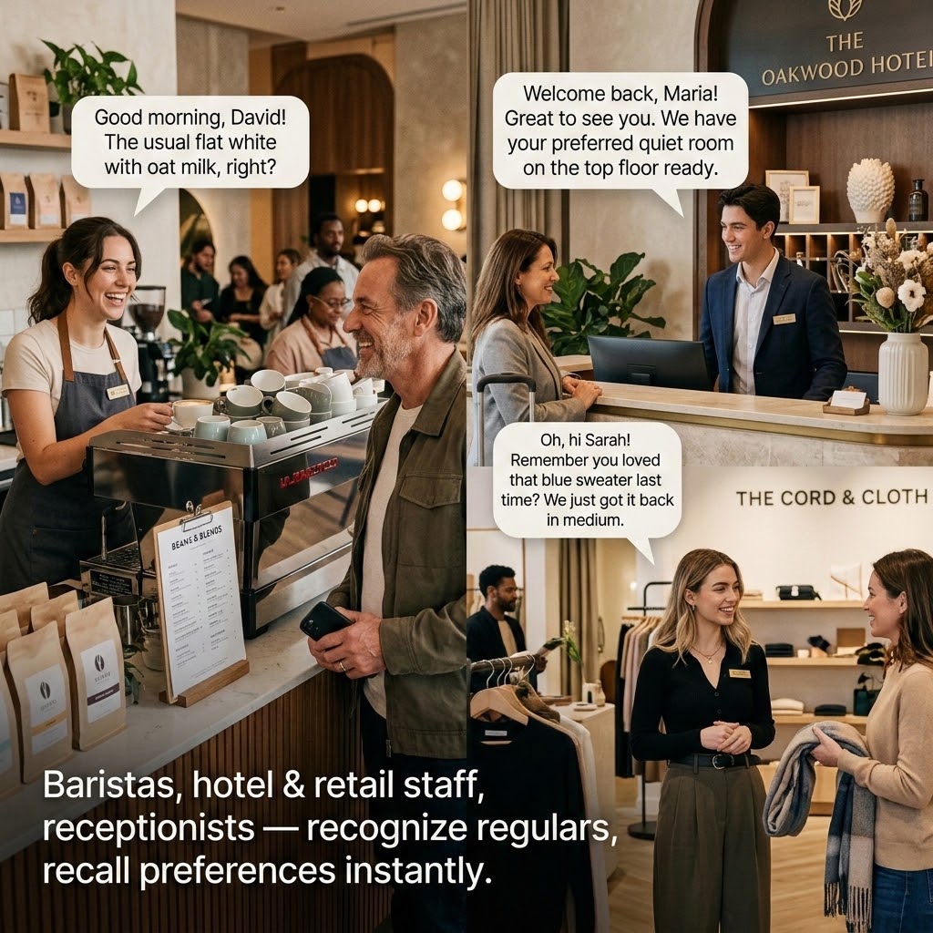
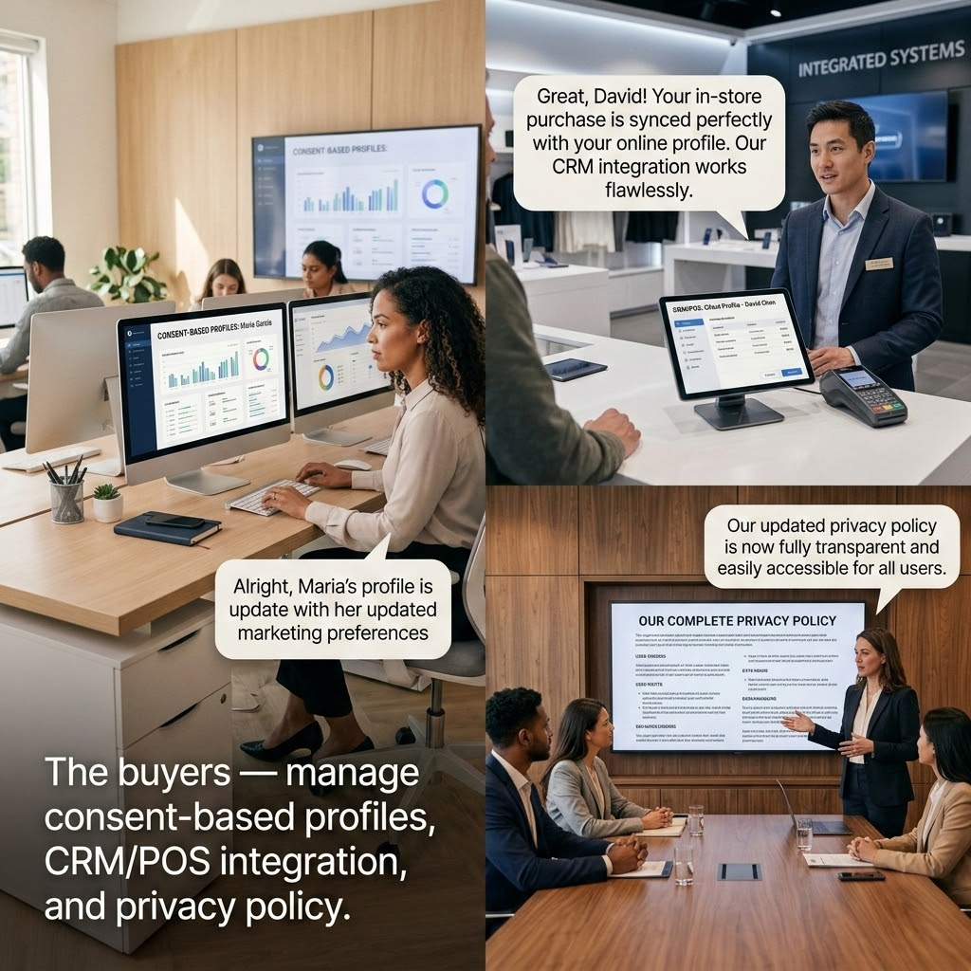
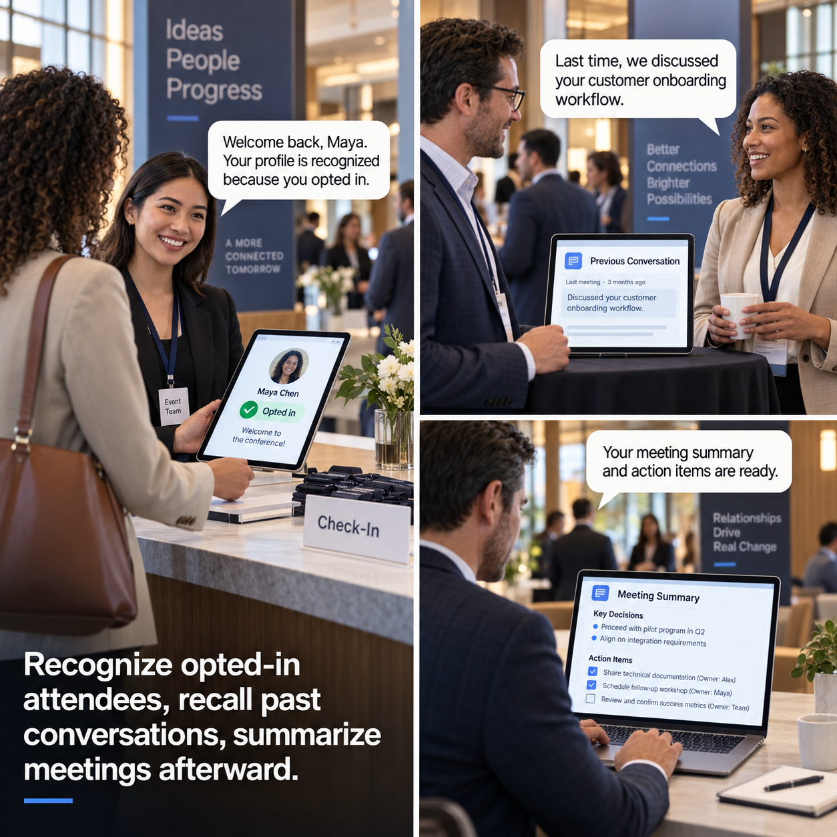
03 · TARGET USERS & TASKS
Three users, three tasks, one outcome
PERSONA 1
PERSONA 2
PERSONA 3
Service employees
Ops & CX managers
Event & conference staff
Notes:
1 minute. Three personas, three core tasks, and the success definition: user, task, outcome.

Slide 4
04 · EXISTING TOOLS & GAPS
Every piece exists. Nobody closes the loop.
Smart glasses & face-recognition APIs
CRM, POS & directories
Voice assistants & note apps
DOES WELL
DOES WELL
DOES WELL
Rich preferences, history, and professional identity data.
Record and summarize speech reliably.
Cameras, audio, displays; accurate face detection and matching.
FALLS SHORT
FALLS SHORT
FALLS SHORT
Manual search only — the employee must stop working to look anything up.
No link between what was said and an authorized identity — notes float free of people.
No organization-specific memory, no consent workflow, no business context.
System | Does well | Falls short
Ray-Ban Meta / Display | Mature hardware, open camera and display SDK | No personalized, face-linked memory recall
Rewind / Limitless pendants | Captures and searches past conversations | No real-time recognition in the moment
INMO GO3 / Rokid Glasses | In-lens AR display already built in | Closed or immature third-party developer SDKs
The gap: no consumer product combines real-time face recognition, LLM reasoning, and an AR display for personal memory assistance.
4
Notes:
1 to 1.5 minutes. Each existing tool solves one piece; none closes the loop hands-free at the moment of service. Connect to /literature/.

Slide 5
05 · LITERATURE SYNTHESIS
Four themes across 8 papers
01
02
Privacy & Consent
Proactive Retrieval
Always-on visual sensing creates severe bystander privacy concerns and transparency issues.
→ A consent-first architecture matching embeddings strictly against pre-enrolled, opted-in profiles with full deletion rights.
(Liu et al.)(Cheng et al.)
Moving from passive screen-mirroring to proactive agents that infer intent in real-time.
→ An automated retrieval pipeline that surfaces order history, roles, and past summaries hands-free.
(Wang et al.)(Liu et al.)
03
04
Ergonomics & Interaction
Computational Constraints
Head-mounted displays enhance decision comfort over handheld screens.
→ A hands-free HUD and audio interface that preserves eye contact and offers subtle input modes for busy work environments.
(Fang et al.)(Pfeifer et al.)
Continuous vision and generative AI on wearables cause severe thermal, battery, and compute bottlenecks
→ A split-edge design that offloads heavy facial embeddings and lookups to an external node via event-driven triggers.
(Wang et al.)(Yang et al.)(Liu et al.)
Notes:
Always-on visual sensing creates severe bystander privacy concerns, power imbalances, and lack of transparency regarding facial recognition and undetected recording(Liu et al.)(Cheng et al.)
→ our consent-first database architecture where facial embeddings are compared strictly against pre-enrolled, opted-in profiles with explicit user deletion rights(Liu et al.)
Wearable AI is shifting from passive screen-mirroring displays to proactive agentic reasoners that continuously infer latent context and user intent to assist in real-time interactions(Wang et al.)(Liu et al.)
→ our agentic retrieval pipeline that automatically surfaces regular orders, roles, and past conversation summaries hands-free without stopping to manually search a database(Liu et al.)(Yang et al.)
Head-mounted displays offer superior technological embodiment over handheld screens by lowering mental intangibility and enhancing decision comfort, but require multi-posture, non-intrusive input methods for physical work environments(Fang et al.)(Pfeifer et al.)
→ our hands-free heads-up display and audio interface that preserves natural eye contact while providing quick, subtle input modes to confirm or dismiss customer profile lookups(Fang et al.)(Pfeifer et al.)
Executing continuous computer vision and generative AI on wearable hardware causes severe thermal, battery, and compute bottlenecks, requiring split runtimes and on-demand sensor triggers(Wang et al.)(Yang et al.)
→ our split-edge architecture offloading facial embedding and database lookups to an external compute node with event-driven capture triggers(Wang et al.)(Liu et al.)

Slide 6
06 · INITIAL CONCEPT & GENAI VALUE
Glasses see. AI recalls. Humans decide.
CAPTURE
RECOGNIZE
RETRIEVE
CONFIRM
Webcam feed simulates glasses camera
→
ArcFace embedding,
cosine match
→
Notes for enrolled, consented people only
→
LLM drafts a one-line reminder overlay
EXAMPLE PROMPT
Why GenAI is essential
"Alice — met at CS orientation, works in ML."
Facial embeddings enable recognition, not just detection
LLM turns raw notes into a natural, ready-to-read reminder
Threshold-based matching avoids false-positive spam
Notes:
1 to 1.5 minutes. Walk the pipeline left to right, then land the point: GenAI is functionally essential — embeddings, speech, and summarization are the product, not decoration.

Slide 7
07 · MILESTONES & NEXT STEPS
Checkpoint 2: prove recognition works
VALIDATE NEXT
BIGGEST UNKNOWNS
IMMEDIATE NEXT STEPS
CP2 validation
Test recognition accuracy and LLM response latency across 5+ enrolled people, varied lighting and angles.
False-match rate in real conditions, LLM latency versus a real-time feel, real hardware integration.
Finalize the prototype, begin user testing, and draft the ethics and consent framework.
USER
TASKS
OUTCOME
→
1 · Recognize consented person
2 · Retrieve approved context
3 · Summarize the interaction
→
ContextLens. remember people, keep humans in control.
Employee mid-interaction,
hands busy
Personal service in <2s,
no broken flow
Notes:
30–45 seconds. What Checkpoint 2 validates, the biggest risks, and immediate next steps. End on the ask/close.

